Slide 1



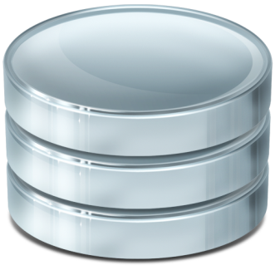

ORM Fundamentals
The ORM Concept, Config, CRUD Operations
ORM Frameworks
SoftUni Team
SQL
Technical Trainers
Software University
http://softuni.bg

Slide 2

Table of Contents
ORM Technologies: Basic Concepts
ORM: Advantages and Disadvantages
Writing an ORM Framework from Scratch
Retrieving Entities from Database
Mapping Navigation Properties
Change Tracking
Generating SQL

Slide 3
Questions
sli.do #CSharpDB

Slide 4
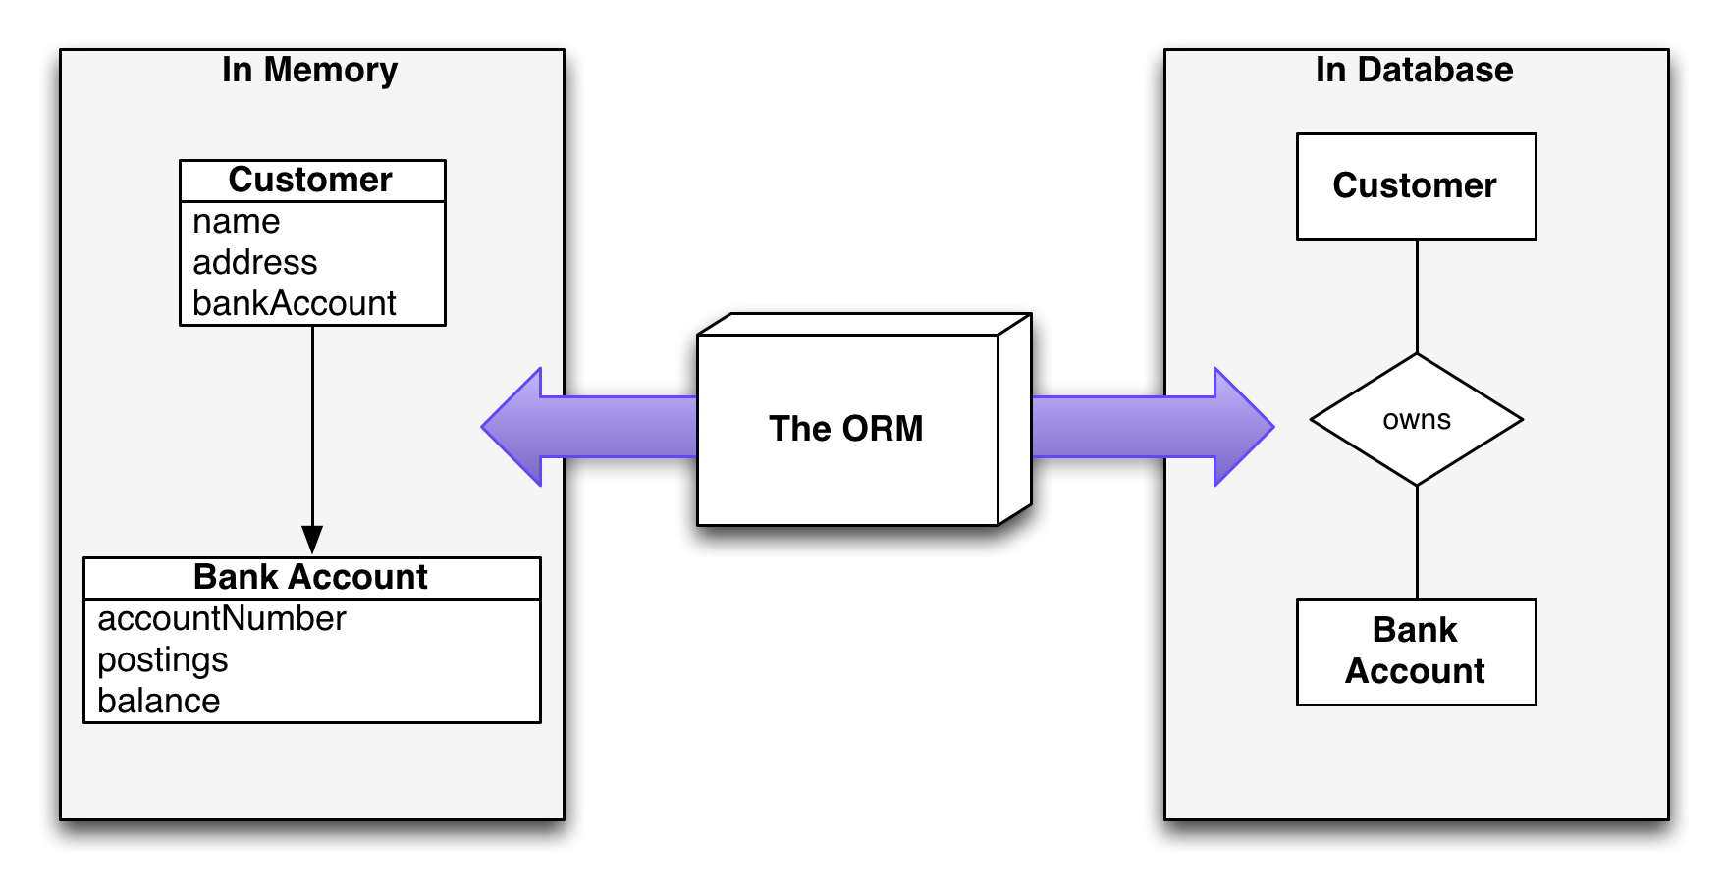
Introduction to ORM
Object-Relational Mapping

Slide 5
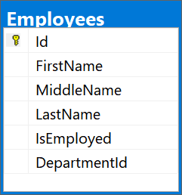
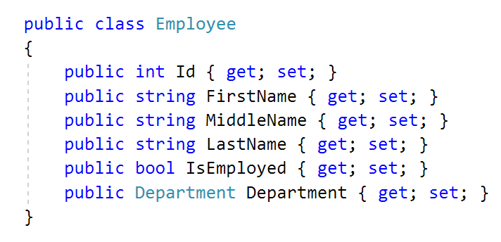
What is ORM?
Object-Relational Mapping (ORM) allows manipulating databases using common classes and objects
Database Tables ➔ C#/Java/etc. classes

Slide 6
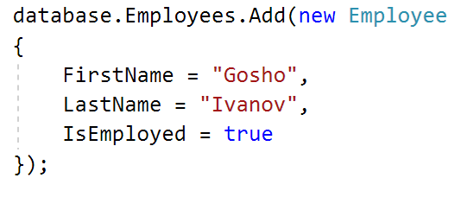
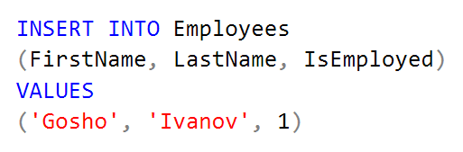
ORM Frameworks: Features
ORM frameworks typically provide the following functionality:
Automatically generate SQL to perform data operations
Create object model from database schema (DB First model)
Create database schema from object model (Code First model)
Query data by object-oriented API (e.g. LINQ queries)

Slide 7
ORM Advantages and Disadvantages
Object-relational mapping (ORM) advantages
Developer productivity: writing less code
Abstract from differences between object and relational world
Manageability of the CRUD operations for complex relationships
Easier maintainability
Disadvantages:
Reduced performance (due to overhead or autogenerated SQL)
Reduces flexibility (some operations are hard to implement)

Slide 8
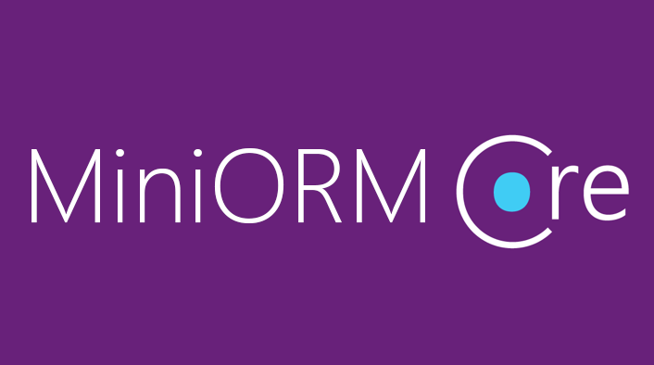
Custom ORM Framework
Overview and Features

Slide 9
MiniORM Core: Overview
Designed after Entity Framework Core
Provides LINQ-based data queries and CRUD operations
Change tracking of in-memory objects
Maps navigation properties
Maps collections
One-to-many, Many-to-many, etc.

Slide 10
MiniORM Core Workflow: Overview
Define data model (database-first)
Entity Classes
DbContext (with DbSets)
Initialize DbContext
Using connection string
Query data, using context
Manipulate data (add/remove/update entities)
Context gets persisted into database

Slide 11
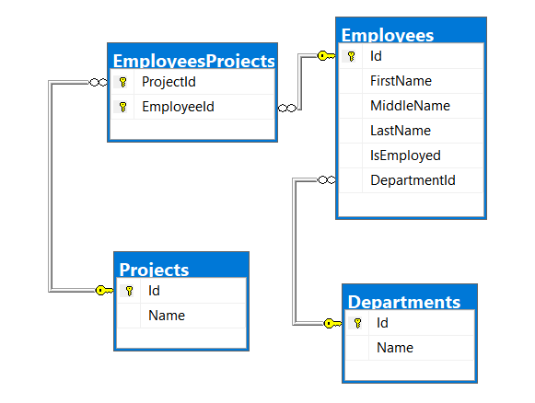
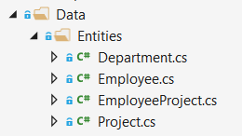
Database First Model
Database First model models the entity classes after the database

Slide 12
MiniORM Components
The DbContext class
Holds the database connection and the DB Sets
Provides LINQ-based data access
Provides change tracking, and an API for CRUD operations
DB Sets
Hold entities (objects with their attributes and relations)
Each database table is typically mapped to a single C# class

Slide 13
MiniORM Components (2)
Associations (relationship mappings)
An association is a primary key / foreign key-based relationship between two entity classes
Allows navigation from one entity to another
MiniORM supports one-to-one, one-to-many and many-to-many relationships
var courses = student.Courses.Where(…);

Slide 14
Entity Classes
Data Holders

Slide 15
Entity Classes
Entity classes are regular C# classes
Used for storing the data from the DB in-memory

Slide 16
Entity Classes: Navigation Properties
Reference type properties
Point to relevant object, connected by foreign key
Set by the framework
Example: Employee’s Department:
public class Employee
{
public int Id { get; set; }
...
[ForeignKey(nameof(Department))]
public int DepartmentId { get; set; }
public Department Department { get; set; }
}

Slide 17
Entity Classes: Navigation Properties (2)
Navigation Properties can also be collections
Usually of type ICollection<T>
Holds all of the objects whose foreign keys are the same as the entity’s primary key
Set by the ORM framework
public class Department
{
public int Id { get; set; }
...
public ICollection<Employee> Employees { get; set; }
}

Slide 18
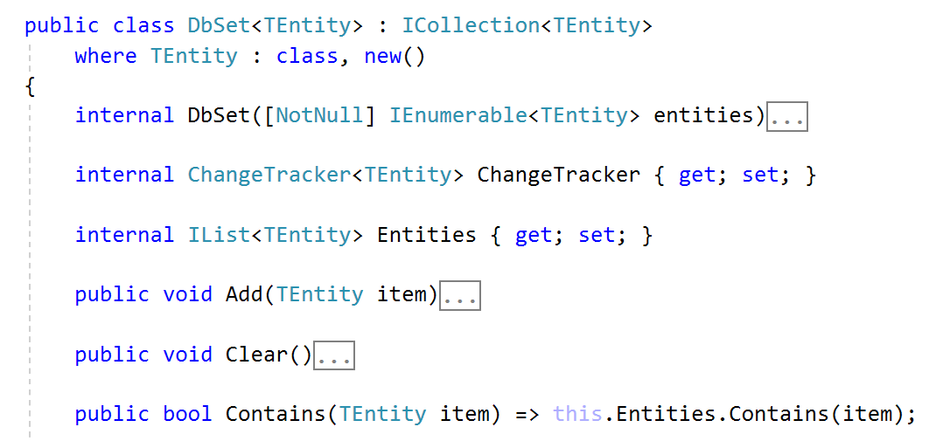
DbSet<T>
Specialized Collections

Slide 19
DbSet<T> Class
Generic collection with additional features
Each DbSet<T> corresponds to a single database table
Inherits from ICollection<T>
foreach-able
Supports LINQ operations
Usually several DbSets are part of a DbContext

Slide 20
DbSet<T> Features
Each DbSet tracks its own entities through a change tracker
Has every other feature of an ICollection<T>
Adding/Updating elements
Removing an entity/a range of entities
Checking for element existence
Accessing the count of elements

Slide 21
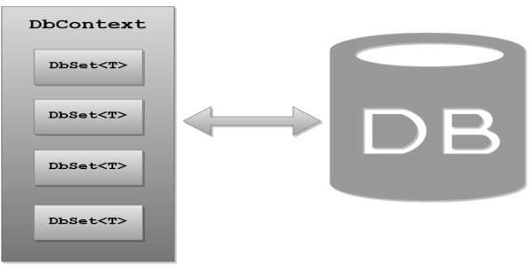
DbContext

Slide 22
DbContext Class
Holds several DbSet<T>
Responsible for populating the DbSets
Users create a DbContext, which inherits from DbContext
Using one DbSet per database table
public class SoftUniDbContext : DbContext
{
public DbSet<Employee> Employees { get; }
public DbSet<Department> Departments { get; }
public DbSet<Project> Projects { get; }
public DbSet<EmployeeProject> EmployeesProjects { get; }
}

Slide 23
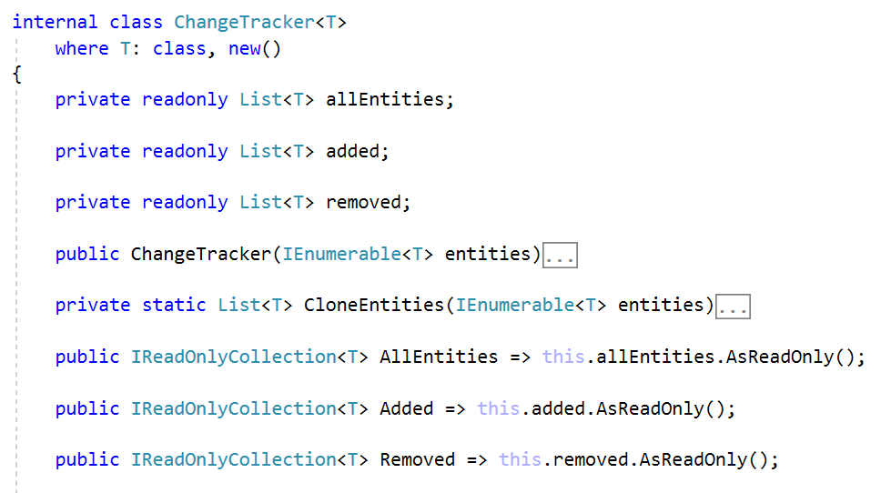
ChangeTracker<T>
Change Tracking Class

Slide 24
ChangeTracker<T>
Container for tracking changes
Holds 3 collections:
All entities
Added entities
Removed entities
Also can track modified entities
Through cloning entities at initialization

Slide 25
ChangeTracker<T>: Cloning Entities
In order to check for entity modification, the change tracker clones all entities on initialization
Cloning process:
Create new blank instance of entity
Find all properties, which are valid SQL types
Set blank instance’s property values to existing entity values

Slide 26
ChangeTracker<T>: Cloning Entities (2)
Cloning Process:
private static List<T> CloneEntities(IEnumerable<T> entities)
{
var clonedEntities = new List<T>();
var propertiesToClone = // TODO: get properties with SQL types
foreach (var entity in entities) {
var clonedEntity = Activator.CreateInstance<T>();
foreach (var property in propertiesToClone) {
var value = property.GetValue(entity);
property.SetValue(clonedEntity, value);
}
clonedEntities.Add(clonedEntity);
}
return clonedEntities;
}

Slide 27
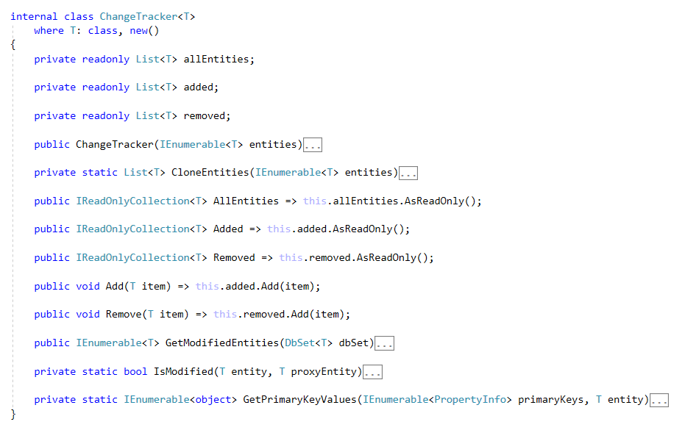
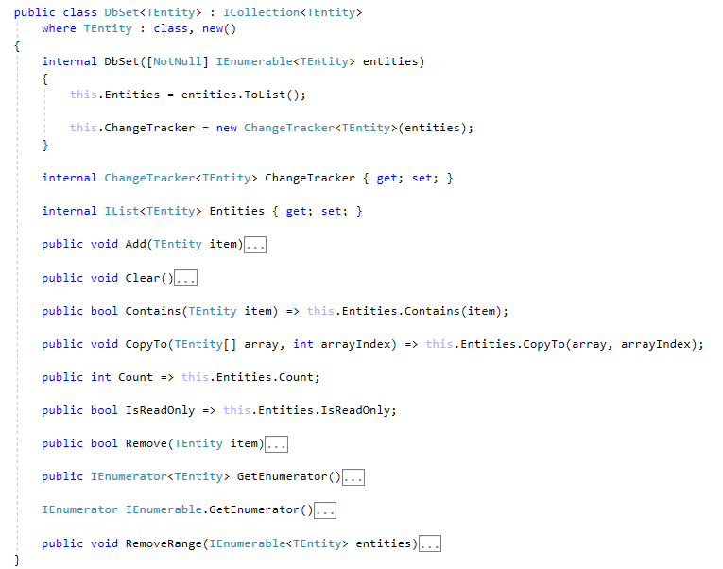
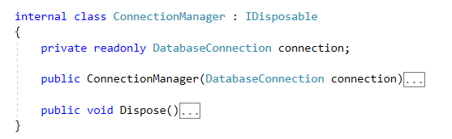
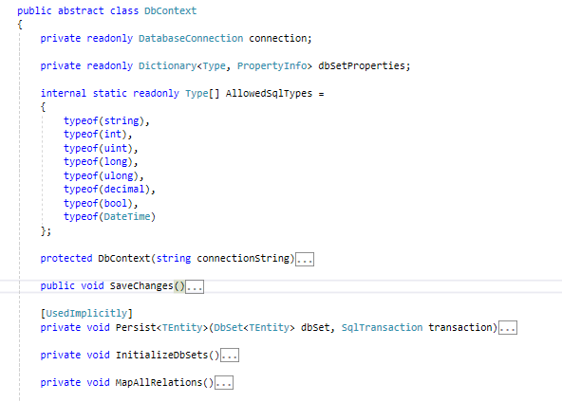
Writing an ORM Framework
Live Demo

Slide 28

Reading Data
Querying the DB using MiniORM

Slide 29
Using DbContext Class
First create instance of the DbContext:
In the constructor you can pass a database connection string
DbContext properties:
All entity classes (tables) are listed as properties
e.g. DbSet<Employee> Employees { get;}
var context = new SoftUniDbContext(connectionString);

Slide 30
Reading Data with LINQ Query
Executing LINQ-to-Entities query over entity:
Employees property in the DbContext:
var context = new SoftUniDbContext(connectionString)
var employees = context.Employees
.Where(e => e.JobTitle == "Design Engineer")
.ToArray();
public class SoftUniDbContext : DbContext
{
public DbSet<Employee> Employees { get; }
public DbSet<Project> Projects { get; }
public DbSet<Department> Departments { get; }
}

Slide 31
Reading Data with LINQ Query
We can also use extension methods for constructing the query
Find element by ID
var context = new SoftUniDbContext(connectionString)
var employees = context.Employees
.Where(c => c.JobTitle == "Design Engineering")
.Select(c => c.FirstName)
.ToList();
var context = new SoftUniEntities()
var project = context.Projects.Single(e => e.Id == 2);
Console.WriteLine(project.Name);

Slide 32
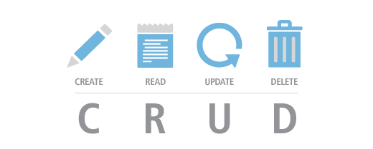
CRUD Operations
With MiniORM

Slide 33
Creating New Entities
To create a new database row use the method Add(…) of the corresponding DbSet:
Create a new Project object
var project = new Project()
{
Name = "Judge System"
};
context.Projects.Add(project);
context.SaveChanges();
Add the object to the DbSet
Execute SQL statements

Slide 34
Updating Existing Entities
DbContext allows modifying entity properties and persisting them in the database
Just load an entity, modify it and call SaveChanges()
The DbContext automatically tracks all changes made on its entity objects
SELECT the first order
Employees employee =
context.Employees.First();
employees.FirstName = "Alex";
context.SaveChanges();
Execute an SQL UPDATE

Slide 35
Deleting Existing Data
Delete is done by Remove() on the specified entity collection
SaveChanges() method performs the delete action in the database
Mark the entity for deleting at the next save
Employees employee =
softUniEntities.Employees.First();
softUniEntities.Employees.Remove(employee);
softUniEntities.SaveChanges();
Execute the SQL DELETE command

Slide 36
Summary
ORM frameworks map database schema to objects in a programming language
LINQ can be used to query the DB through the DB context
var employees = context.Employees
.Where(c => c.JobTitle == "Design Engineering")
.Select(c => c.FirstName)
.ToList();

Slide 37







ORM Fundamentals
https://softuni.bg/courses/databases-advanced-entity-framework

Slide 38






SoftUni Diamond Partners

Slide 39


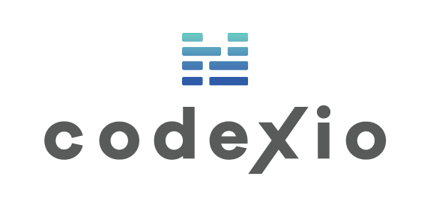



SoftUni Diamond Partners

Slide 40
License
This course (slides, examples, demos, videos, homework, etc.) is licensed under the "Creative Commons Attribution-NonCommercial-ShareAlike 4.0 International" license
Attribution: this work may contain portions from
"Databases" course by Telerik Academy under CC-BY-NC-SA license

Slide 41





Trainings @ Software University (SoftUni)
Software University – High-Quality Education, Profession and Job for Software Developers
softuni.bg
Software University Foundation
http://softuni.foundation/
Software University @ Facebook
facebook.com/SoftwareUniversity
Software University Forums
forum.softuni.bg

